Slide 1

KEYCDA 2023 Annual General Meeting
Activity Report
Lamin Jammeh
Board Chairperson

Slide 2

Introduction
Kombo East youth and Children Development Alliance (KEYCDA) is a youth and child led organization established by young people of Kombo East District with the spirit to unify and empower the young people of the District.
KEYCDA since inception has upheld to this spirit and continue to provide enabling environment for young people to be united and harness their innate potentials.
This report represents the activities conducted by the Alliance during the year under review 2023.

Slide 3
Objectives
Seek to inform the general membership of KEYCDA and partners as to the activities conducted over the year.
It seek to identify our best practices and achievements
It seeks to identify our gaps and the way to mitigate the further occurrence of some of the challenges and mistakes we underwent during the period under review.
It will help guide us in the planning of our future programs and activities.

Slide 4
Main Activities
During the year under review, KEYCDA embarks on series of activities both within and outside the District. Below are some of the activities recorded:

Slide 5
Capacity Building
KEYCDA has organised series of capacity building initiative for the young people of District but equally members of the organization participated in different capacity building programs organised by partners and other organizations.

Slide 6
KEYCDA Innovative Leadership Program (KILP)
KEYCDA inaugurated the maiden Leadership Program. The KILP program is designed to inculcate and nurture responsible leadership concept for sustainable community development into the young people.
The program came as a result of the leadership gaps seen to be existing within our communities and the country at large.
The program has successfully graduated nineteen young people from within Kombo East and Beyond as its first cohort.
We are happy to report that, the program has indeed benefited the participants, the manifestation of which is the launching of a street light project by one of the participants in her community. All the participants have their own project to run within their various communities.

Slide 7

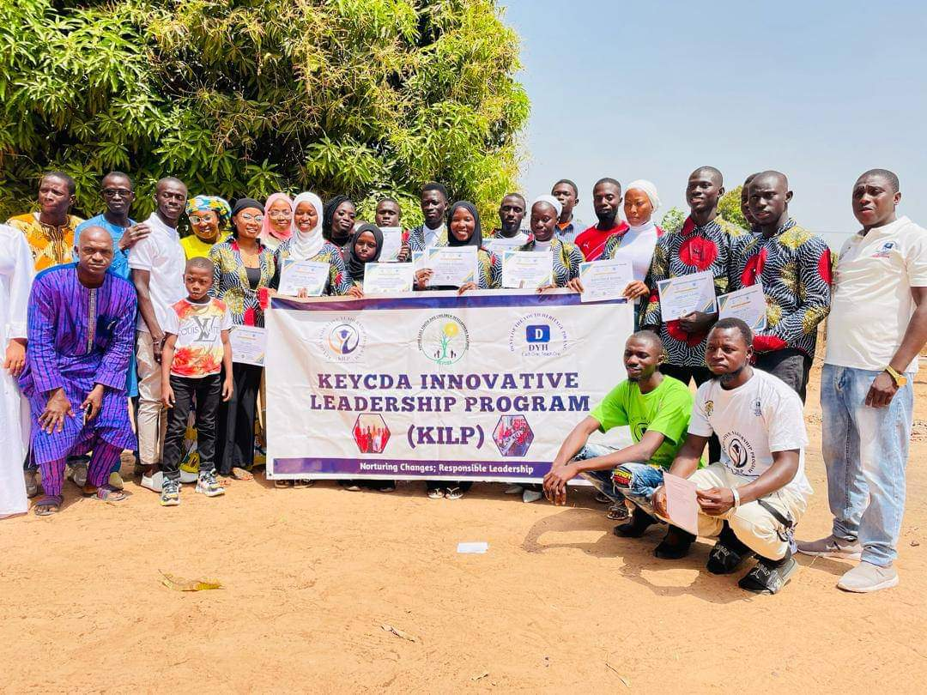
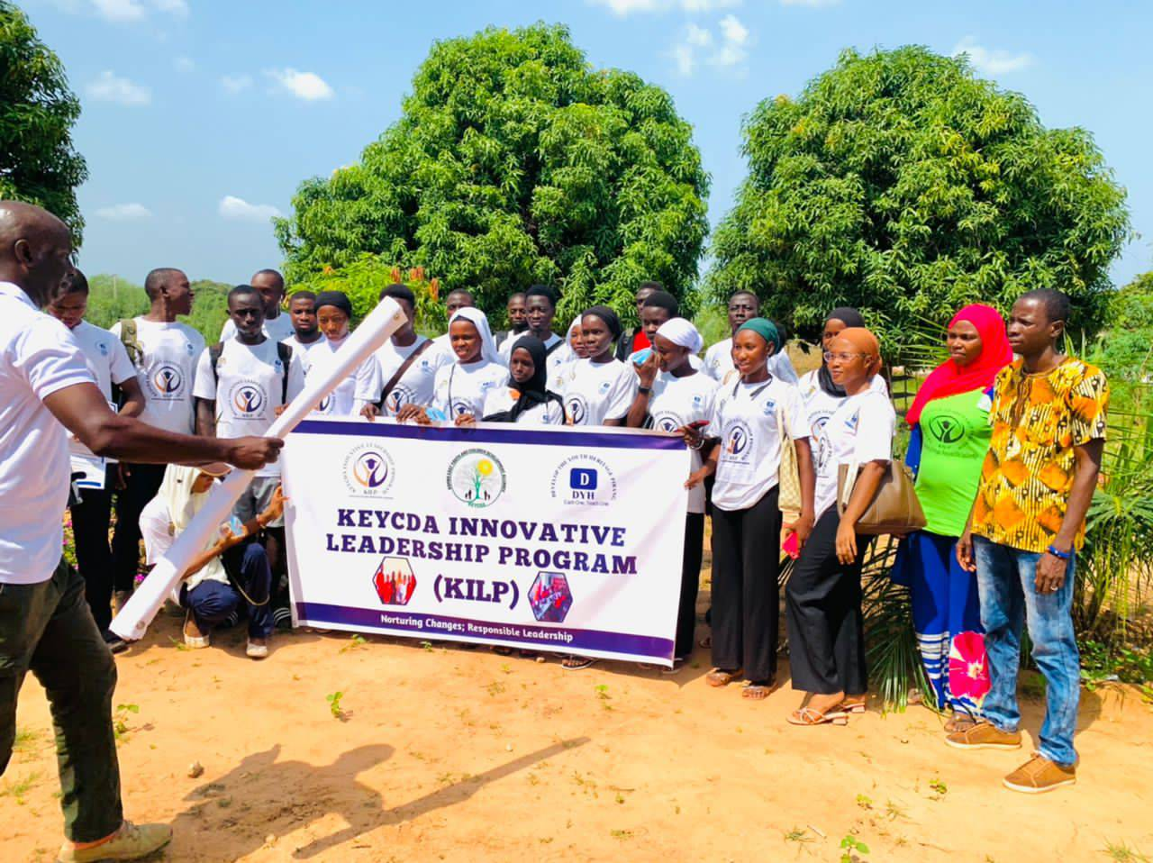

Slide 8
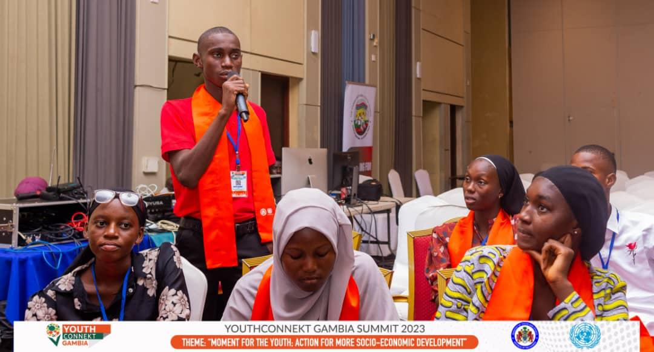
Members of KEYCDA Attended Youth Connekt. Gambia 2.0
As part of our empowerment promise, Binta Gibba, The Vice chairperson of KEYCDA and Salifu Darboe a member of the District Children Committee and clerk of the children Parliament WCR attended youth connect. This convergence is considered to be one of the most important youth gathering in the Gambia organised by National youth council.

Slide 9
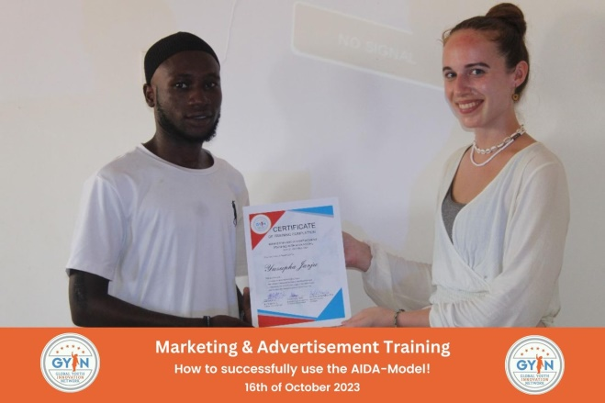
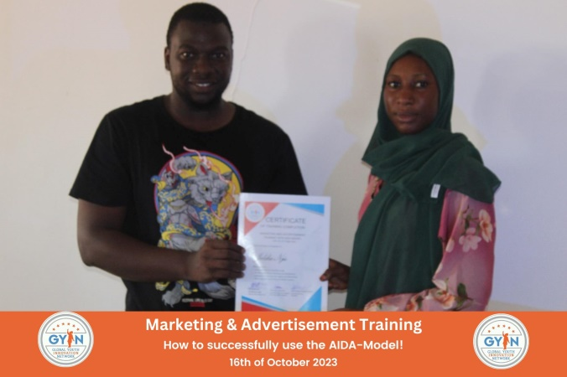
Marketing and advertisement training
Two of the members of the Alliance, Jalika Njie Treasurer, District Assembly for the welfare of girls and Young women and Yusupha Jarju, Deputy Communication officer attended a day long Marketing and advertisement training organized by GYIN Gambia. The package is part of the strategies of the Board to enhance the capacity of young people within Kombo East District.

Slide 10
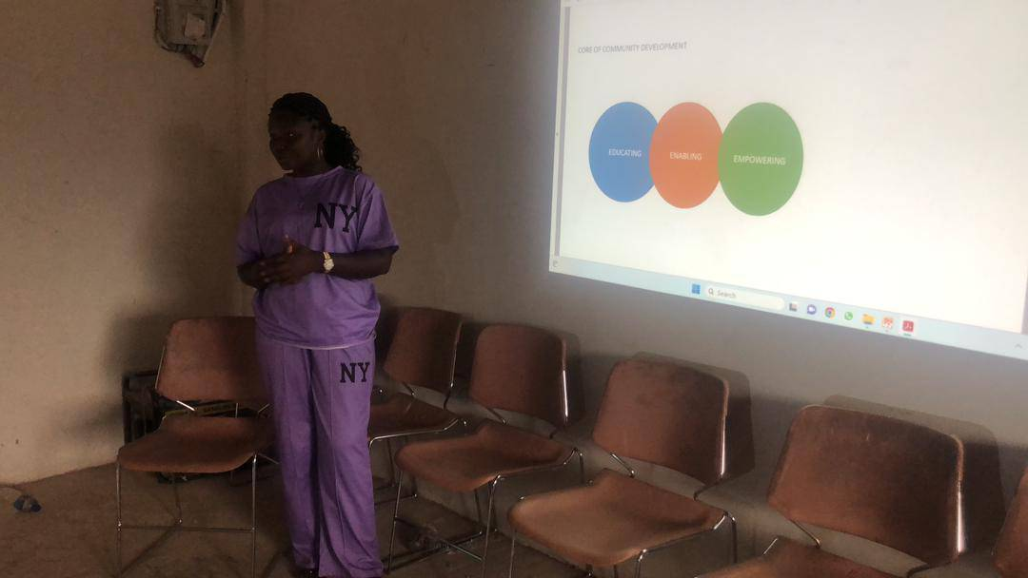
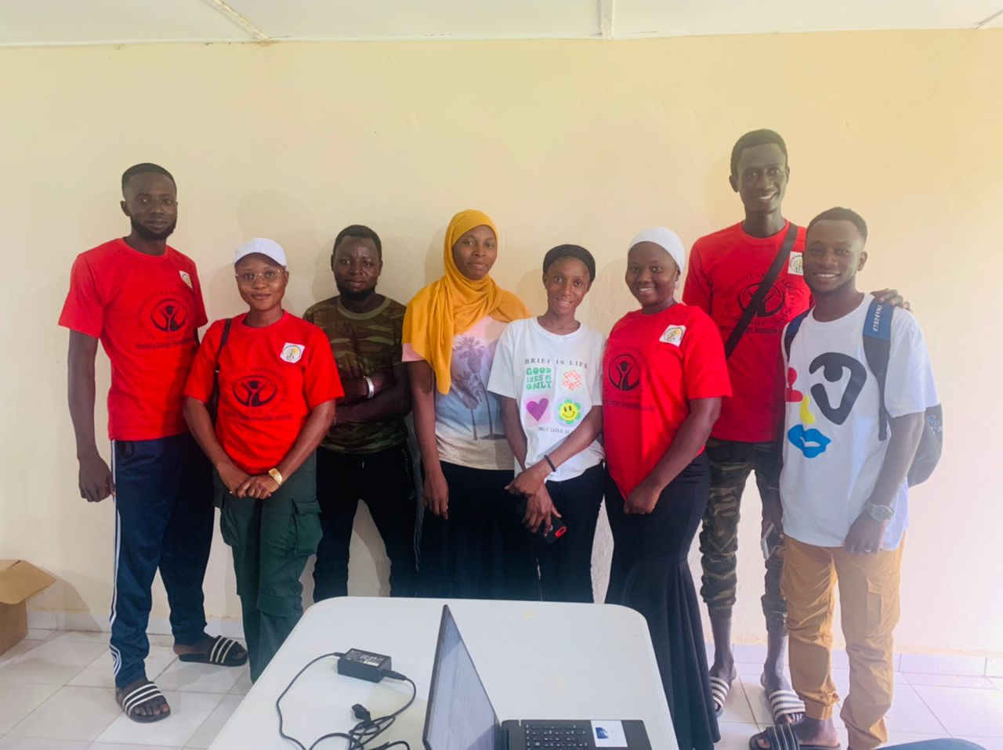
Chaperone’s Training
KEYCDA concludes a 4 weeks long training of chaperones under the KEYCDA Innovative Leadership Program (KILP). As part of its design, the program is required to recruit five chaperones who will serve as coaches and guidance for the program. A call for application was sent where many youth apply and a thorough interview and scrutiny five young were selected and trained for 4 weeks to understand the concept of the program.

Slide 11
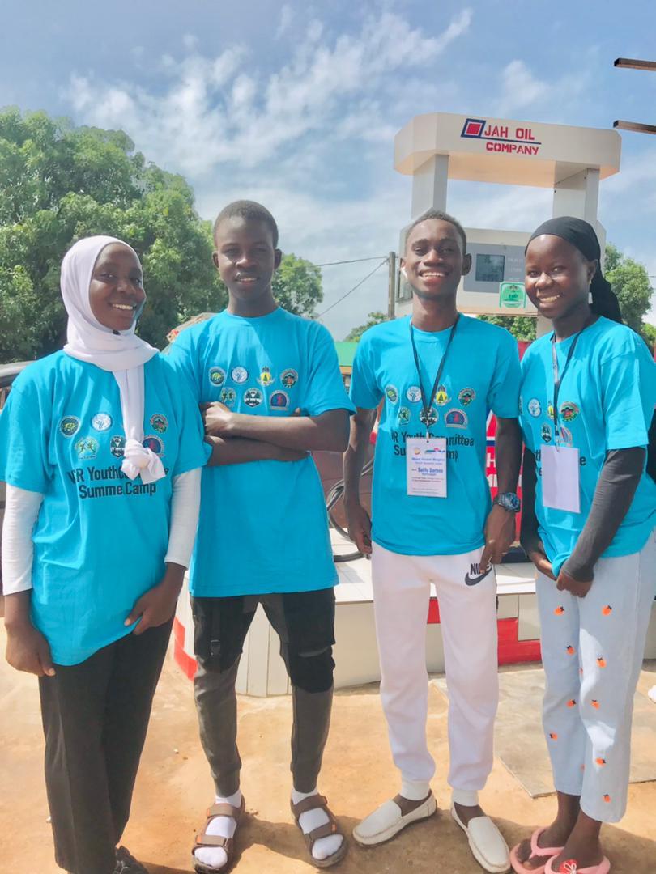
KEYCDA at the WCR Youth Summer Camp 2023
A week-long convergence is being held at Bottrop UBS/SSS from September 1–8, 2023, and several members of the children's committee and the youth committee under the Kombo East Youth and Children Development Alliance were in attendance.
Participants were taken through numerous thematic subfields, such as Child rights, Gender Based Violence, Leadership, Peace and Security, and Sports Administration.

Slide 12
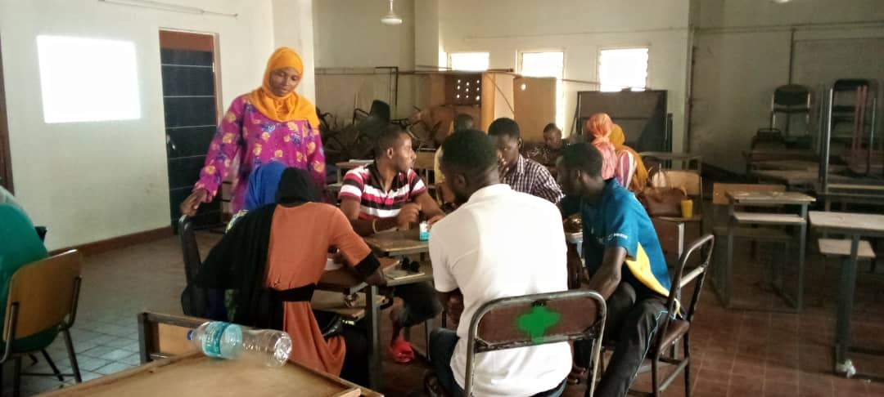
Leadership Training for Gambia College Student Association
Through our KEYCDA Innovative Leadership Program (KILP), we conducted two days leadership training for the executives of the Student Teachers Association (STA) of the Gambia College.
The Training program part of our adhoc services provided to institution and group’s base on their request. Special Thanks to our Board Chairperson Mr. Lamin MS Jammeh who also double as the lead Trainer and Madam Binta Gibba, The Vice Chairperson and the Coordinator KILP for their wonderful deliberations.

Slide 13
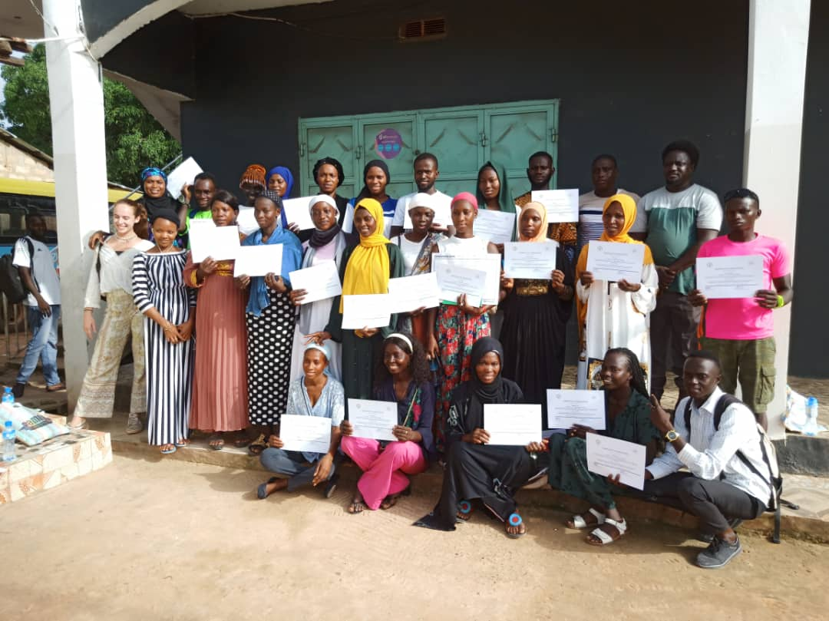
KEYCDA - GYIN Gambia Entrepreneurship Training For the Youth of Kombo East District
KEYCDA in partnership with GYIN Gambia Chapter organized a 2 days capacity building training for 25 young people (youth) within the District.
The capacity building training was centered on Entrepreneurship with the tagline (is this the right venture for your business?) the participants were taken through the following courses:
Leadership and Entrepreneurship Skills
Developing a Business Idea and Model
Business Formalization
Customer Relation
Market and Competitor Analysis
Developing a Communication Strategy.

Slide 14
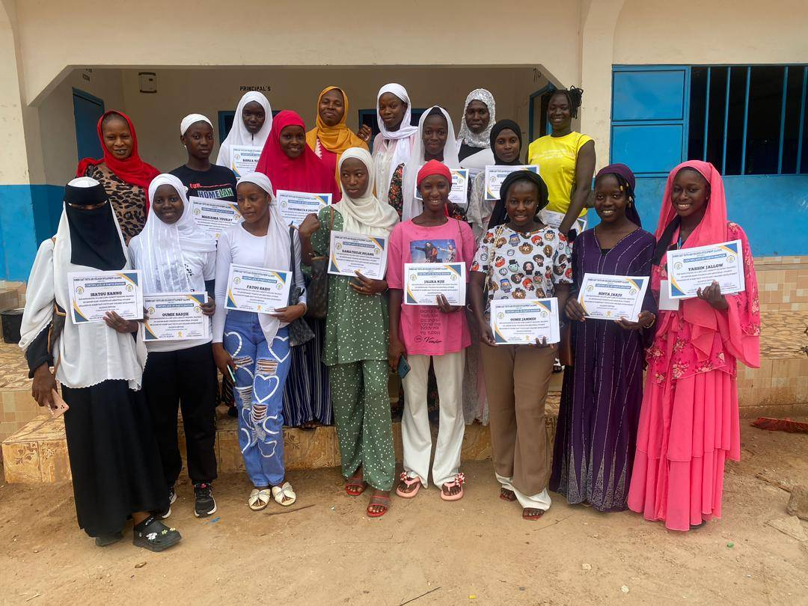
Capacity Building Training for the Executives of the Girls Assembly
In our quest to empower youth and children of Kombo East District, KEYCDA Successfully conducted a day capacity building training on the concept of KEYCDA and sexual reproductive health for the new executive of the District Assembly for the welfare of Girls and young women. This is in line with our strategy plan 2022-2023 under strategy component 1: Youth Empowerment and Development.

Slide 15
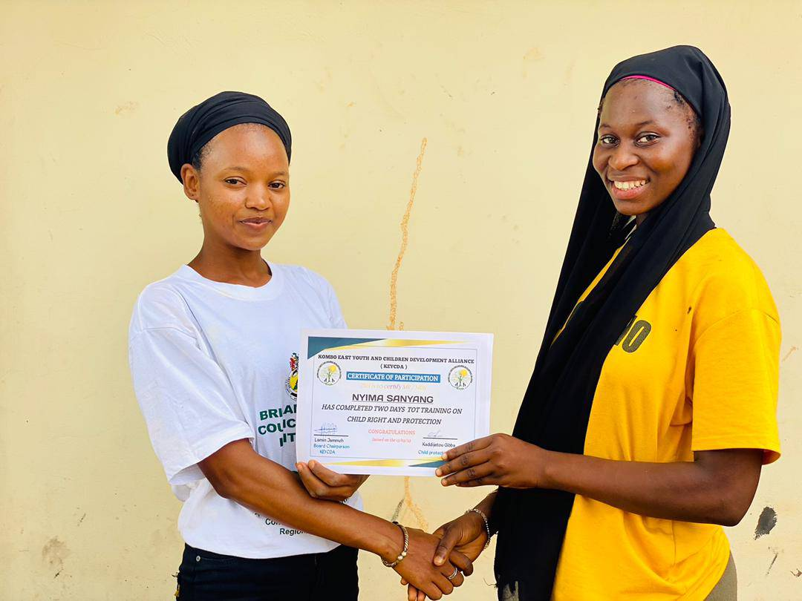
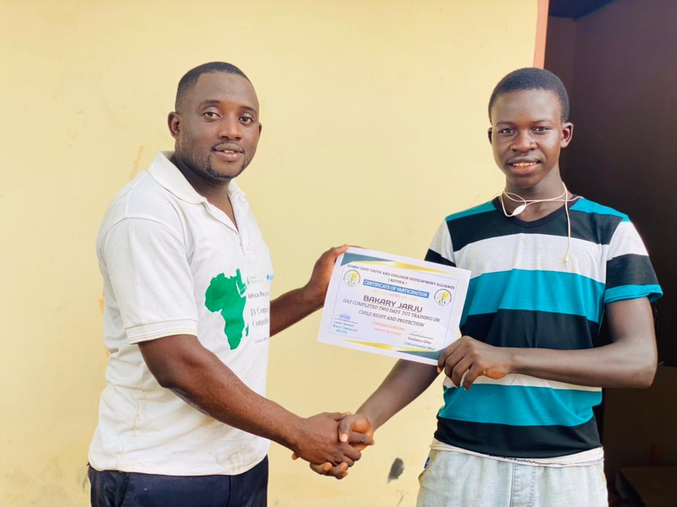
Training on Child Rights and Protection for the members of the Children Committee
KEYCDA organised two days capacity building training for the executive of the children committee. The training which is in a form of training of trainers was aimed at enhancing their understanding on the child rights and protection. The members are expected to conduct a similar training for the members of the student leadership within the schools in Kombo East District.

Slide 16
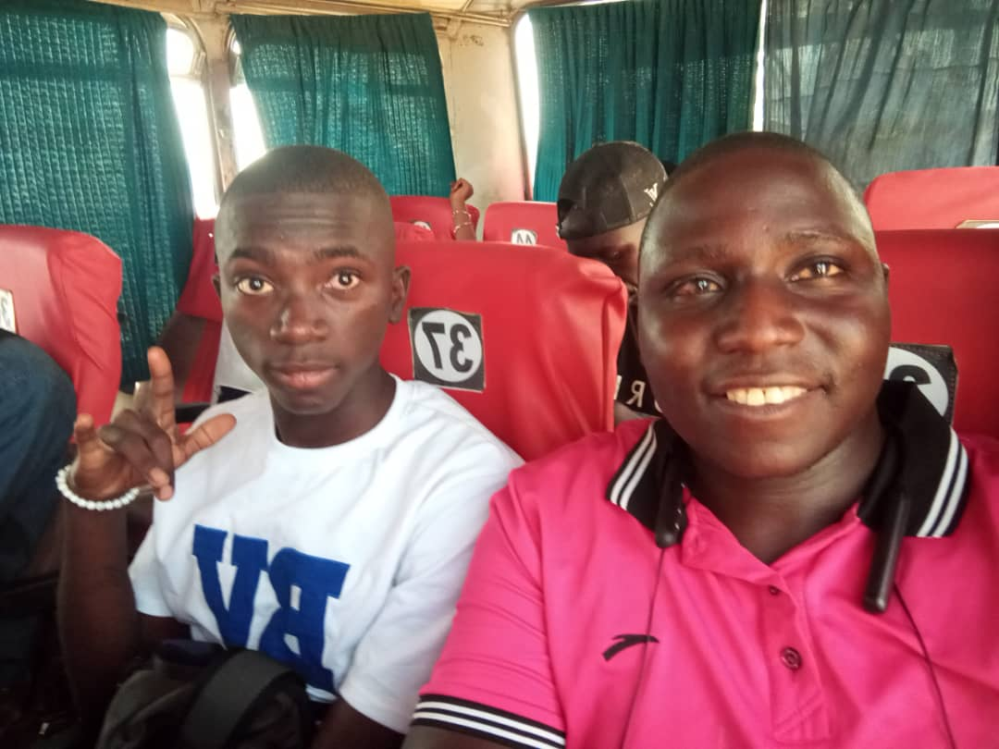
Advocacy on child right Protection held in Thies
KEYCDA supported the attendance of one of the Executive members of the children committee Buba Kassama in week long training on child protection held in Thies Senegal. This is as a result of our partnership with coordination of working Children Youth of The Gambia.

Slide 17
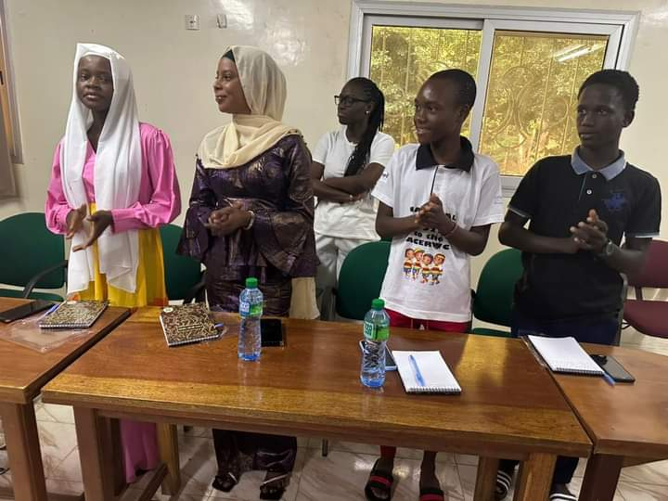
Residential Advocacy workshop, Held in Papaya Residence in Bijilo 16th – 21st August, 2023.
Coordination of working children and youth of the Gambia with the financial support from Swedish international Development cooperation Agency(SIDA) organised a 5 days capacity building on the development of advocacy plan for child-led organization in the Gambia. KEYCDA as a partner organization was represented by the 1st Vice chairperson of the Children Committee Arabiatou Touray.

Slide 18
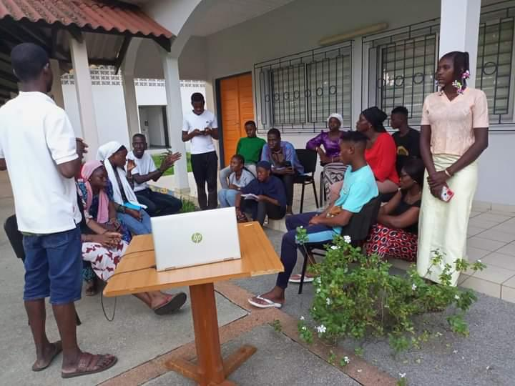
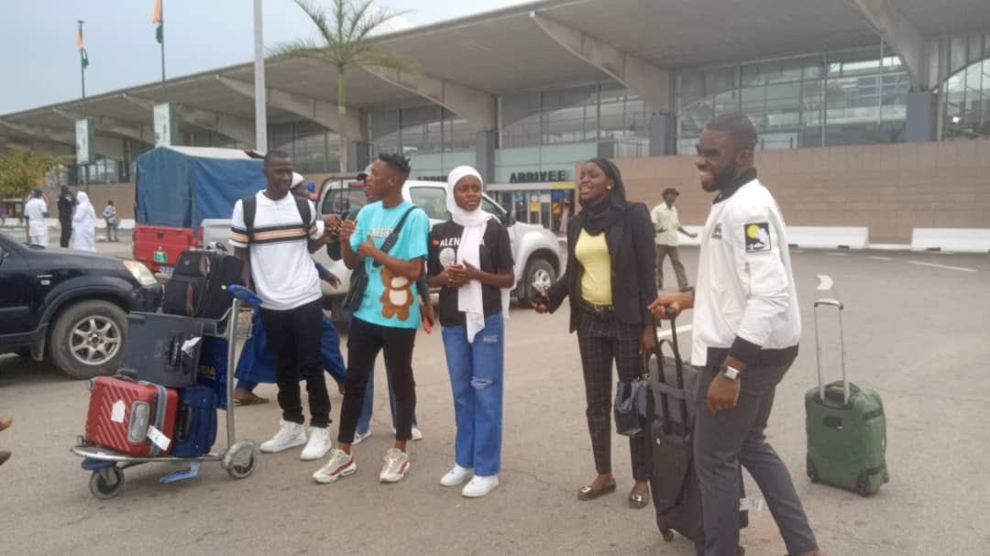
Workshop on Child Participation
Through our partnership with coordination of working Children Youth of The Gambia.
The 1st vice chairperson of the children committee attended a 5 days training child participation organised by MAEJT from the 23rd – 28th November, 2023 at enda Madasahel center, in Mbour Senegal. The workshop was aimed at strengthening effective child participation in our various communities. Participant were drawn from different west African Countries.

Slide 19
Courtesy Calls

Slide 20
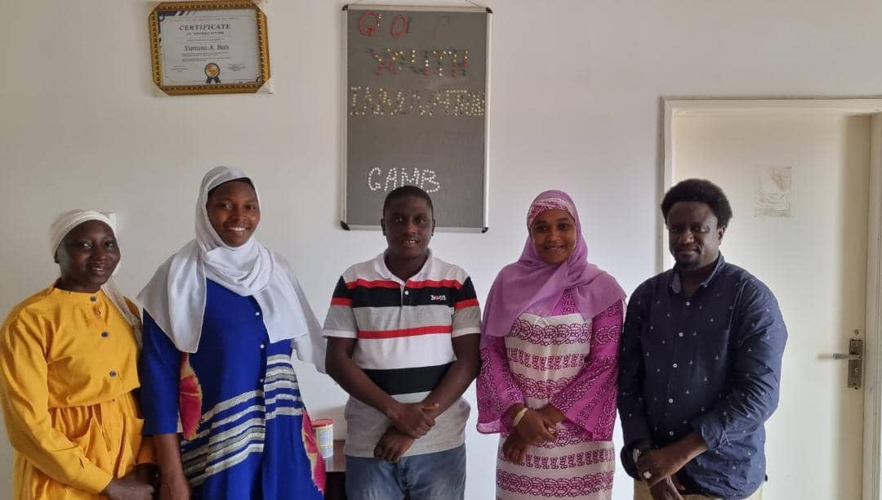
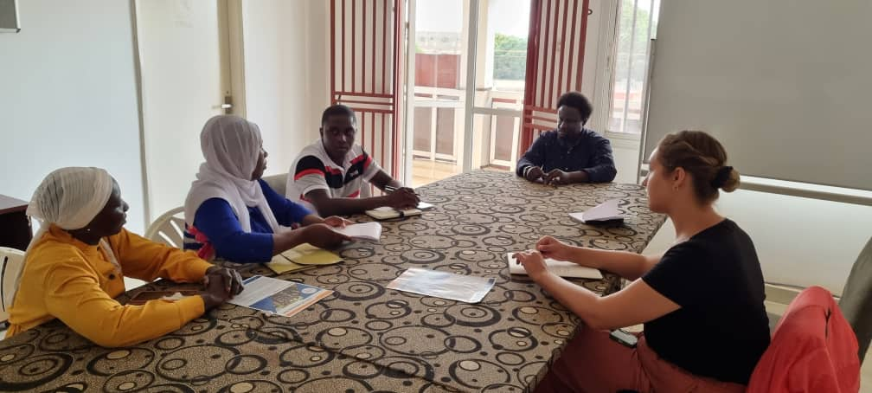
Courtesy call to GYIN Gambia
In our quest to improve our partnership and networking capacity, KEYCDA Board through the Board Chairperson, Vice and the Female representative paid a courtesy call to GYIN Gambia chapter to discuss on possible areas of partnership. The discussion was focus on partnership in the areas of entrepreneurship and skills development.

Slide 21
Courtesy call to the ward committees
To strengthen the bond between KEYCDA and the local Authorities especially the three ward committees within Kombo East District, the Board through the Chairperson and the vice chairperson had a successful meeting with Pirang and Kafuta ward committee. The meeting was focus on popularizing the ‘‘The Whole of Community Approach towards youth development’’ an approached introduce by the Board to call for all inclusion on attaining youth development in Kombo East District.

Slide 22
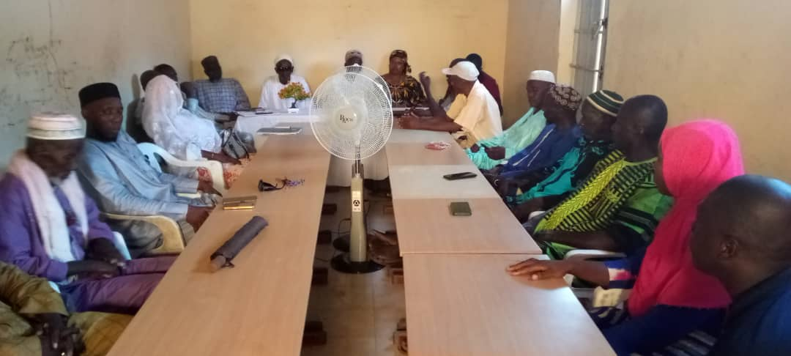
Courtesy Call to the District Alkalo's Association
The KEYCDA Board on the 1st October 2023 paid a courtesy call to the Kombo East Alkalos Association.
The visit is part of the courtesy call plan to meet all the stakeholders within the District within the framework of our whole of Community Approach towards Youth development (Sosolaso).
They further emphasize on the need for collaborative effort from both KEYCDA and Alkalos association to the attainment of development initiatives within the District.
The team equally took the opportunity to lobby for representation the seating of the Alkalo's Association, where they can be able to share the reports on the activities the Alliance.

Slide 23
Other Activities

Slide 24
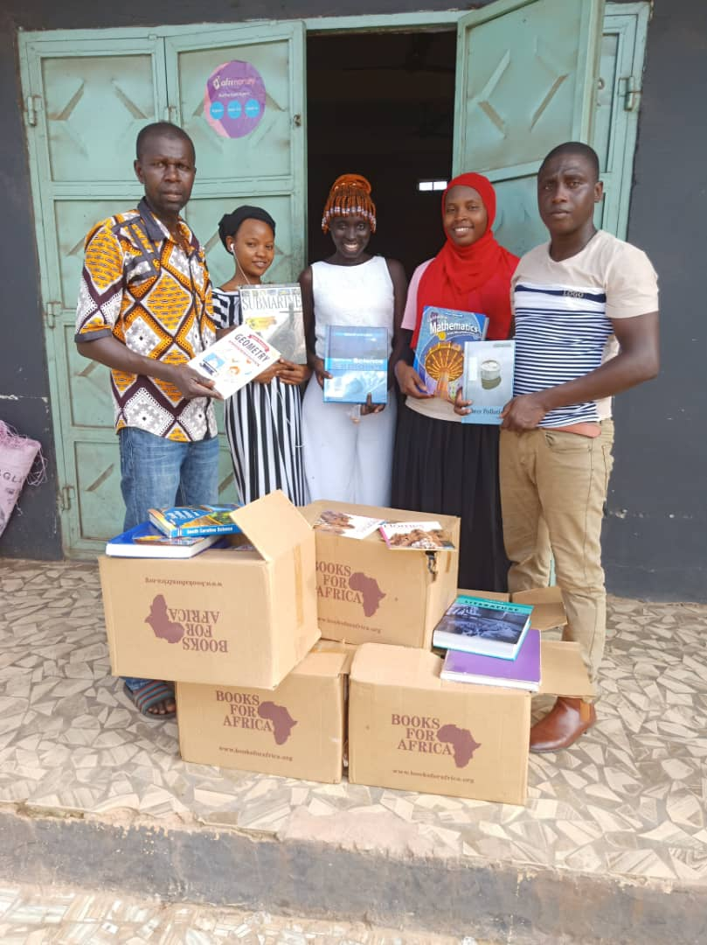
KEYCDA Donates Books to Kuloro Community Association
KEYCDA through the support of Gambia Library Project donated six boxes of Books of different field of studies to Kuloro Community Association Community Library located at Kuloro Village. ''The donation is part of our collaborative efforts to contribute to the development of Children within Kombo East District. KEYCDA since inception has a long standing cooperation with the Five Community Association within Kombo East District and have ever since maintained the spirit of providing quality services to the youth and children of Kombo East District.

Slide 25
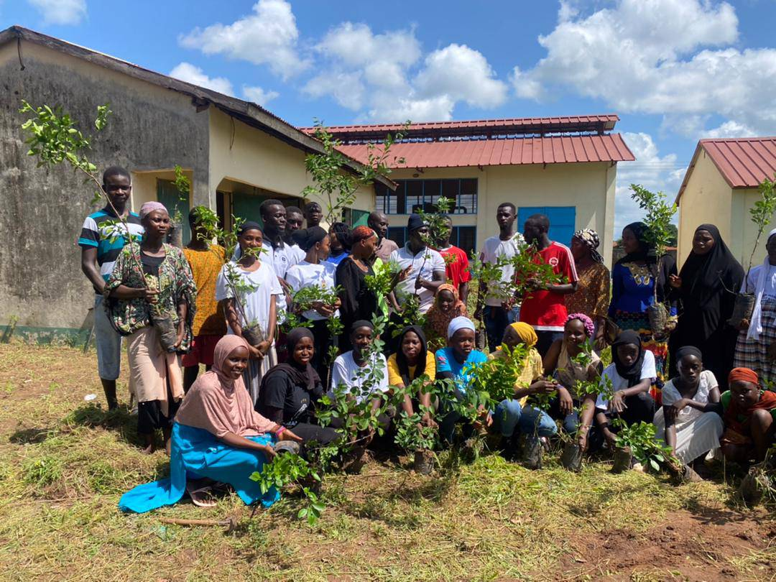
Clearing Exercise and Tree Planting
Kombo East Youth and Children Development Alliance in partnership with daughters of the Gambia have successfully conducted a clearing exercise and Tree planting exercise in its main Office in Kuloro.
This activity is part of KEYCDA development agendas for community building.

Slide 26
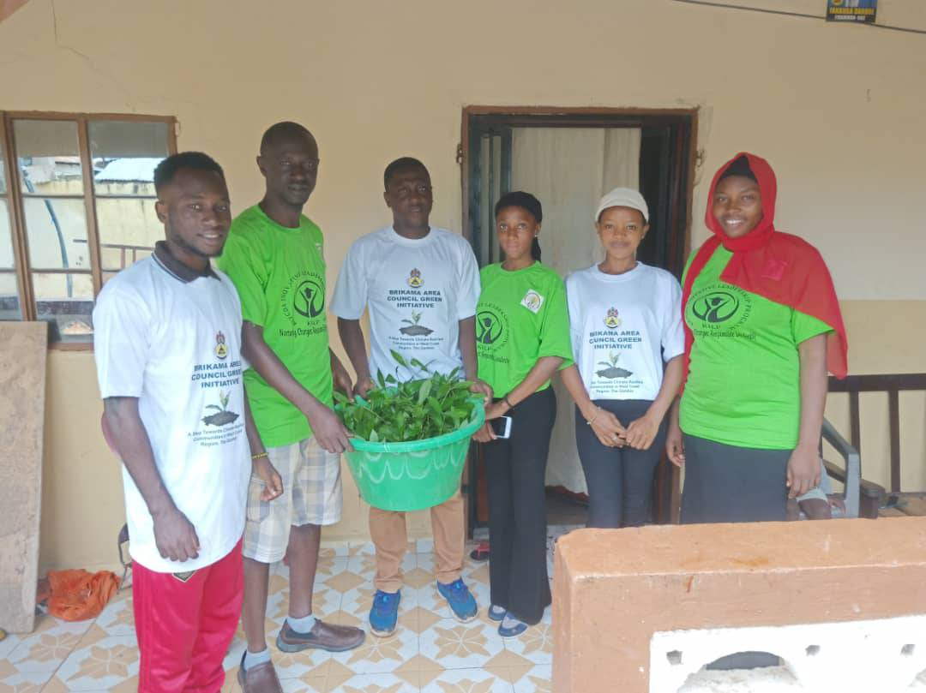
KEYCDA at BAC Tree Planting Exercise in Pirang Village
Members of KEYCDA including the Board Chairperson joined the native of Pirang to partake in the Tree Planting Exercise Initiated by Brikama Area Council in partnership with ST Foundation, NEA and GGCA.
Some Seedlings were also presented to the Councilor of Pirang Ward (Lamin Dibba) to show support towards the initiative.

Slide 27
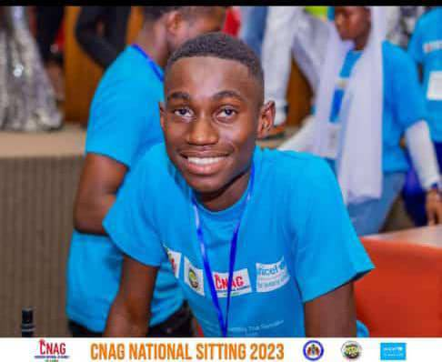
Salifu Darboe of Kombo east at the first ordinary session of the children national assembly in the year 2023
Salifu Darboe alias Salifu Jr Lecturer Darboe is a native of Kuloro village and a member of Kombo East District Children Committee under the umbrella of (KEYCDA).
Salifu who is a grade 10 Student and also one of the icons from the children committee also a representative of KEYCDA at West Coast Children's Assembly.
Attended the first ordinary session of the Children National Assembly 2023 at paradise Suite Hotel.
Known for his excellent public speaking and other child related matters, Salifu was lucky to be elected as the Clerk for West Coast Children's Assembly.

Slide 28
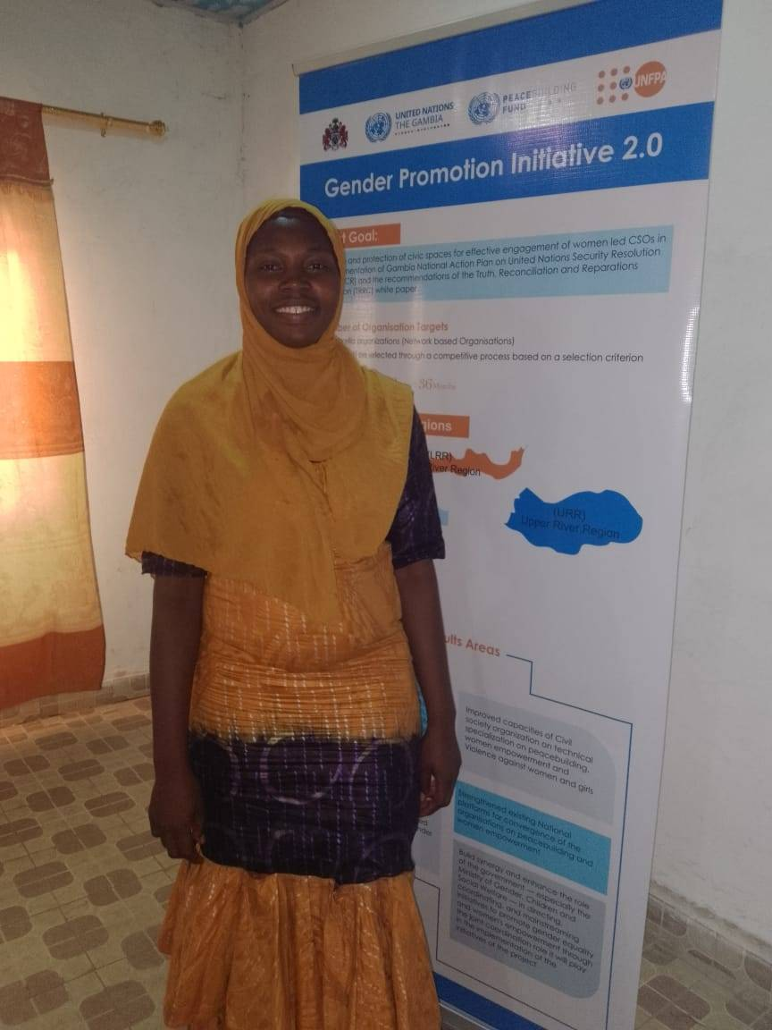
Pre selection orientation of the Gender promotion initiative 2.0 project
Our vice chairperson Ms. Binta Gibba on the 19th June, 2023 attended a pre - selection orientation of the Gender promotion initiative 2.0 project for West Coast Region.
The workshop is organised to prepare NGO's and community based organization for the application of the GPI 2.0 Application procedures.

Slide 29
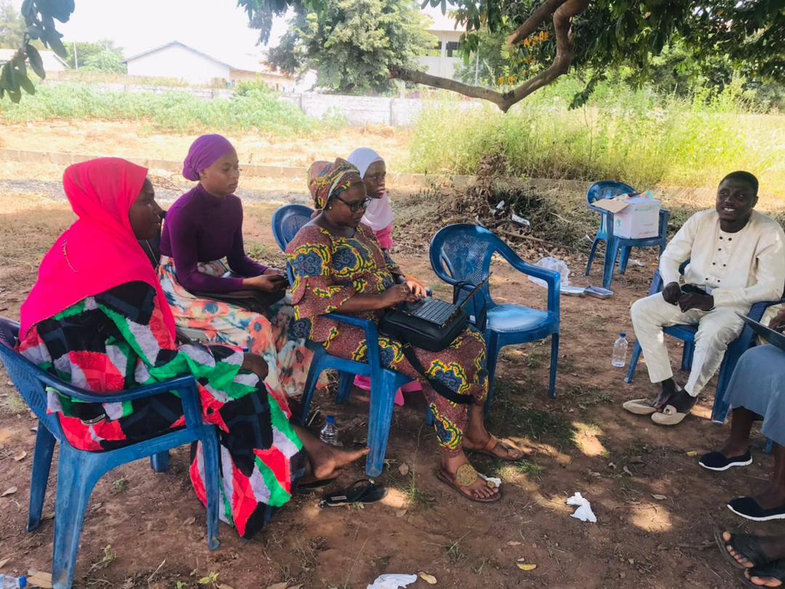
Capacity Assement by UNFPA Gender Promotion initiative project (GPI)
KEYCDA is a project beneficiary to the GPI 2.0. As a project beneficiary to this project, the Leadership of KEYCDA on, held a day long capacity Assessment with the project leader and the team at the KEYCDA office complex in Kuloro. This Assessment is part of the foundation for a possible intervention and support to KEYCDA.
Members who participated regarded the Assessment as a capacity building. Different areas of the institution were assess and an action plan for year 2024 was develop in some of the areas we have gaps.

Slide 30
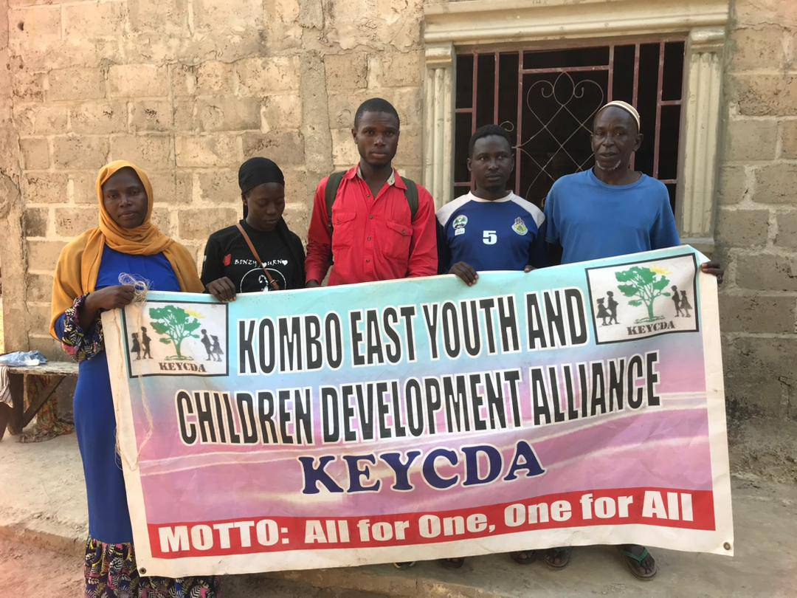
District Caravan
As part of the popularization and commitment to our theme for the 2023 youth convergence; ‘‘The Whole of Community Approach to youth Development’’ members of the organizing committee embarked on a district tour to meet all the Alkalo’s and prominent members of the District to put to their knowledge the concept of convergence.
This initiative was meant to enhance the participation of the local authorities and members of the communities of Kombo East in the development initiative of young people of the District. It is regarded as one of the biggest caravan organised by KEYCDA after the Core founders when they were popularizing the concept of KEYCDA. The team led by the youth chairperson and vice chairperson of KEYCDA have reached to all the 33 communities within District.

Slide 31
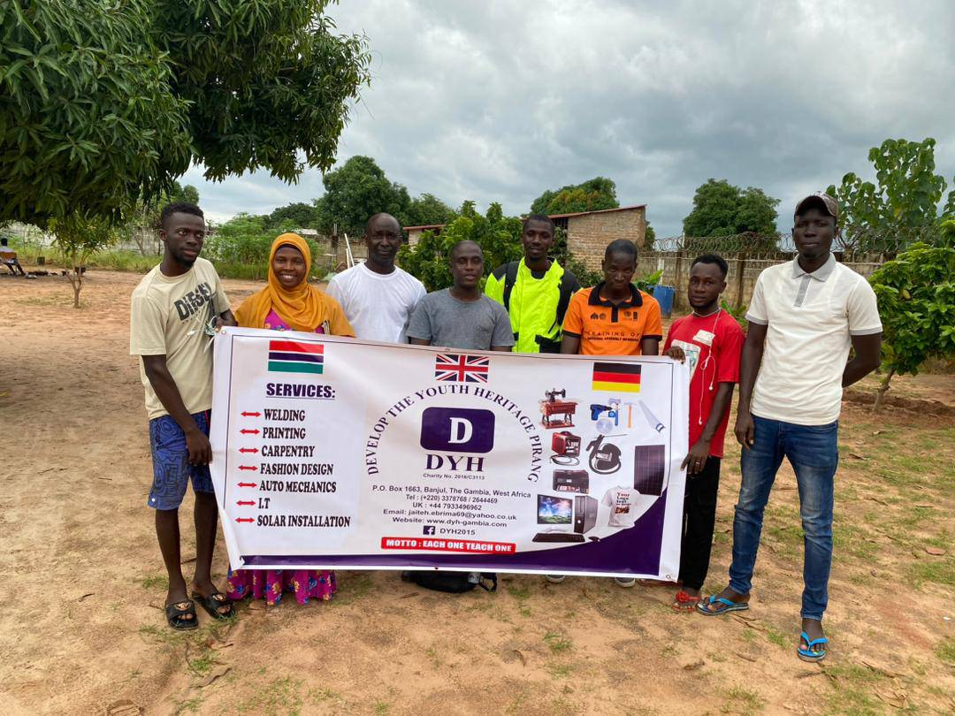
DYH & KEYCDA hold a potential partnership meeting
The KEYCDA board, led by Lamin Jammeh, visited the Develop the Youth Heritage (DYH) Center in Pirang Village on September 28, 2023.
The main goal of the visit was to explore a potential mutual cooperation to support youth development endeavors within Kombo East and beyond.
Develop The Youth Heritage (DYH) is an organization that works with Youth and Children in The Gambia and is dedicated to inspiring and assisting young people in developing their own personal skills and experience in areas such as education, culture, and volunteer work.

Slide 32
KEYCDA Validated constitution and Strategy Plan
During its first days into office, the KEYCDA Board through its sub-organs reviewed and validated the KEYCDA Constitutions and strategy plan 2023- 2026.
This was a follow up activity initiated by the previous board.

Slide 33
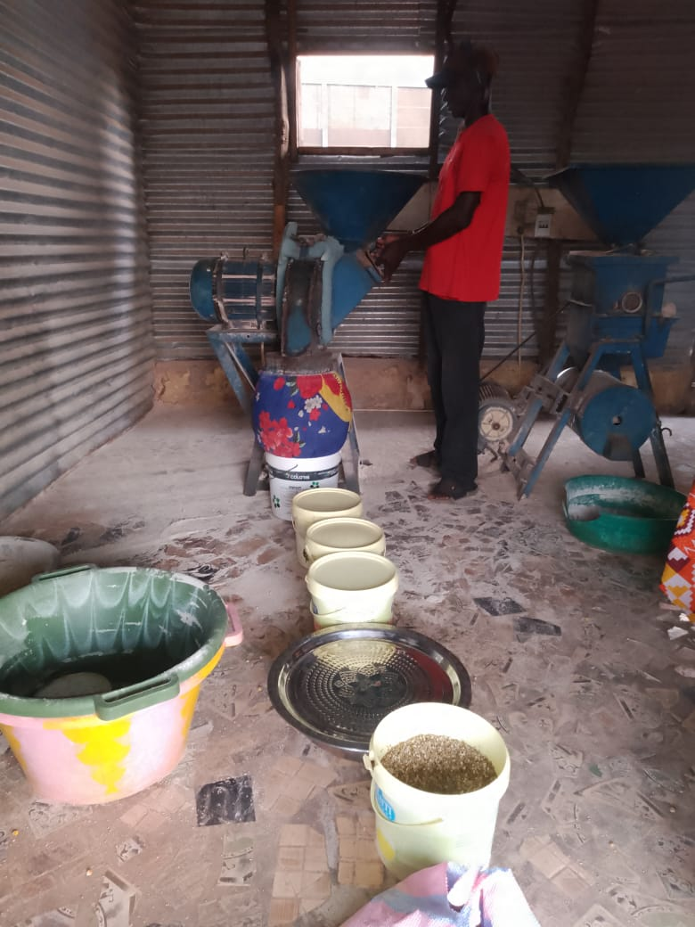
KEYCDA milling Machine Revitalized
As part of its activity plan for the first quarter into the office, the Board promised the young people to revitalised one of the fundraising avenue for the alliance.
I am happy to inform this gathering that, the milling machine which has stopped operation for a while is now fully functional.
Initially, two young people were appointed but currently only one is active.

Slide 34
Meeting with Ministry of Fisheries and FAO
Part of our major concern is the operation of one of the so called bigger project of KEYCDA. ‘‘KEYCDA feed Mill Project’’.
During the year under review. Board and other relevant stakeholders had succesful engagement in regards to how the long awaiting project can be operationalize.
The meeting which consist the permanent secretary and the deputy permanent secretary and other project staff from FAO promised to support the project through their new clory fish project but in 2024.

Slide 35
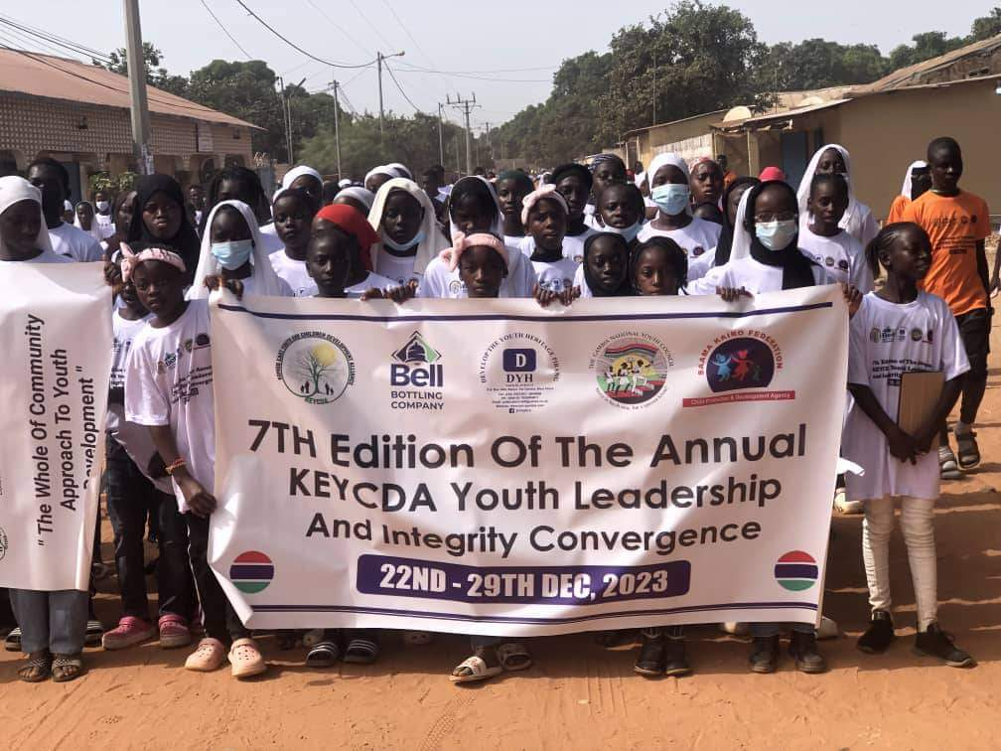
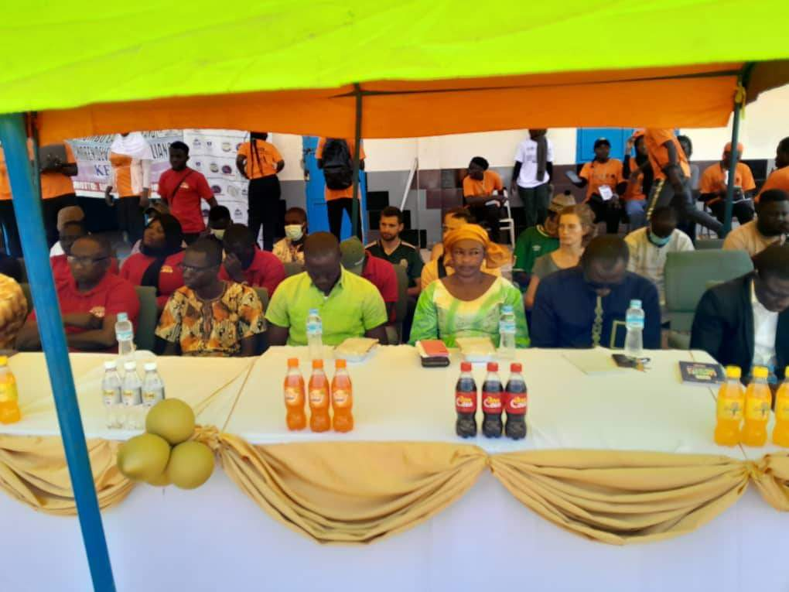
Youth Leadership and Integrity
KEYCDA successfully organised 7th edition of the annual Youth Convergence.
The convergence this year housed more than 300 young people across the Gambia.
Participants were taken through 7 thematic areas.

Slide 36
First Quarter 2024

Slide 37
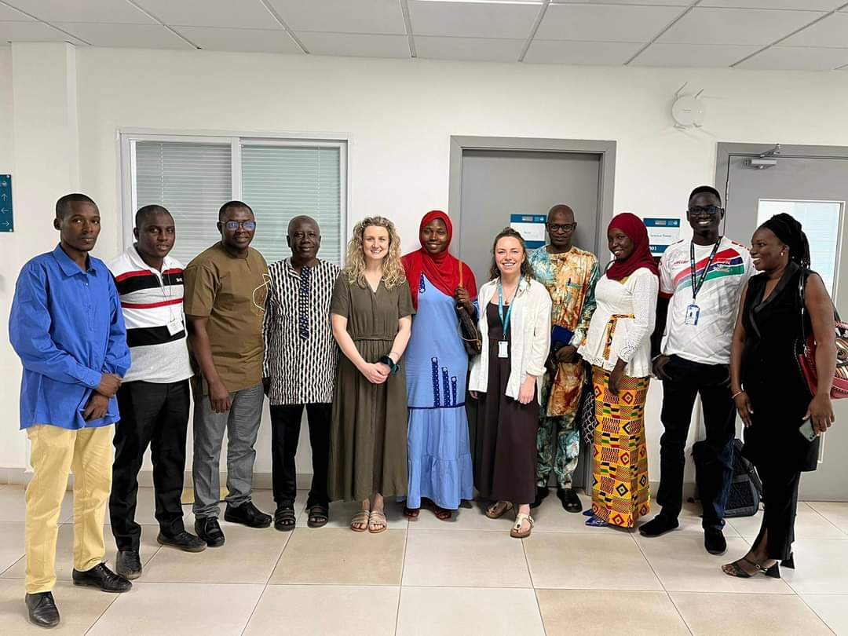
Meeting with MRC Gambia
KEYCDA in the year 2023 participated in consultative workshop in nurturing care for children.
During this year, the Alliance was invited to the second phase of the project to discuss on the implementation plan.
The project which will be implemented in Kiang West will attract KEYCDA as the Technical support.
The Vice chairperson is selected as one of the technical support to the project.

Slide 38
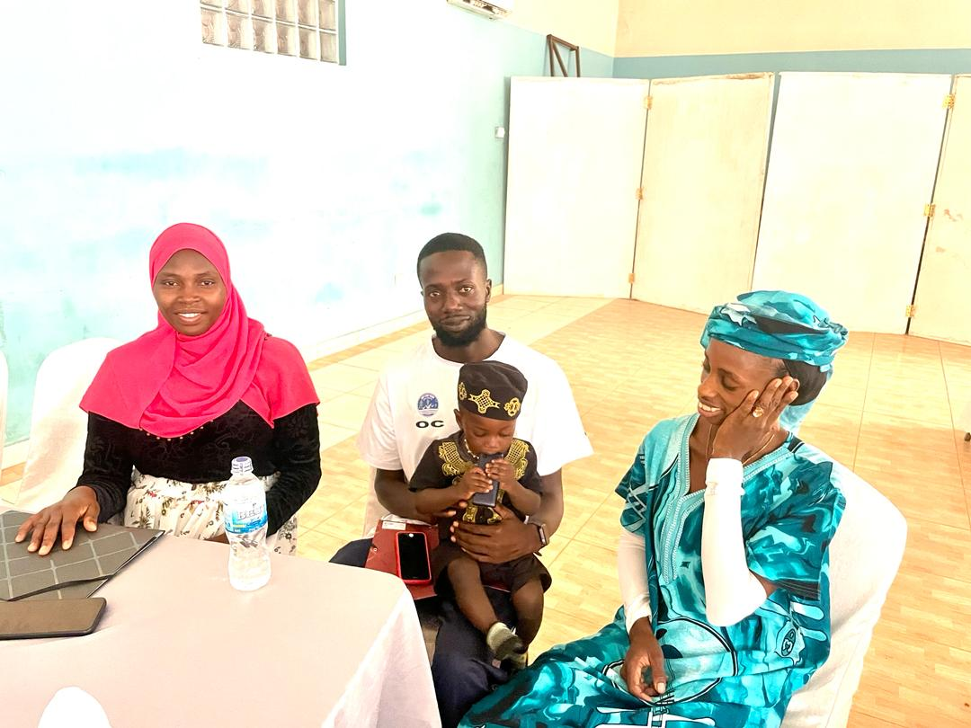
Gender Promotion Initiative (GPI 2.0)
As a beneficiary organisation, KEYCDA participated in the inception workshop of GPI 2.0 on the 16th and 17th April, 2024.
The workshop aims at familiarising implementing CSO’s with tools and strategies for the GPI 2.0 Project roll outs, focusing on institutional capacity building and project implementation.
KEYCDA was represented by the Vice chairperson who double as the project focal person, the Deputy executive secretary and the Finance Officer.

Slide 39
KILP Graduated 20 participants
KEYCDA Innovative Leadership Program(KILP) graduated 20 participants

Slide 40
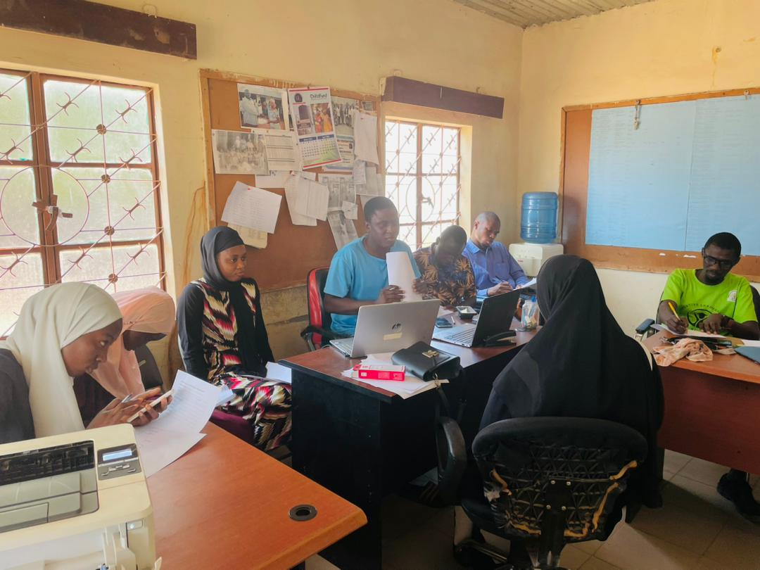
KEYCDA Recruited the 2nd Cohort KILP
KEYCDA Innovative Leadership Program Requited 30 young people for the second batch.
The 2nd batch is schedule to commence sessions in May 2024.

Slide 41
Challenges
Insufficient funding to support the implementation of designed activities.
Lack of commitment from some members in attaining organisational goals.
Inadequate capacity to effectively execute duties among the executive members.
Misconception and misunderstanding of the KEYCDA concept among the executives leading to conflict.
Inactive communication within the executives

Slide 42
Cont..
Inadequate synergy within the service providers or stakeholders supporting youth development endeavours in the District.
Lack of respect for Leadership among some executive members.

Slide 43
Achievements
Launching of the KEYCDA Innovative Leadership Program.
Revitalization of the Milling Machine.
Improve Partnership and Networking capacity of the organisation.
Securing the Gender Promotion Initiative 2.0 Project.
Successfully conducting 7th edition of the annual Leadership & integrity convergence.
Enhanced capacity of members of the Alliance.
Launching the whole of community approach towards youth development.
Succesful stakeholders engagements.

Slide 44
Recommendation
Improve the capacity of the young people of the District in diverse areas of development.
Promote unity and peaceful cohesion among the young people of Kombo East District.
Improve understanding of the KEYCDA Concept among the Executive members of the Alliance.
Expand the KEYCDA outreach to all the communities within Kombo East District.
Enhance partnership and networking with like – minded organisation locally, Nationally, and internationally.

Slide 45


